Slide 2
Welcome to Easter Morning Worship

Slide 3
1 Christ is alive! Let Christians sing.
His cross stands empty to the sky.
Let streets and homes with praises ring.
Love, drowned in death, shall never die!
StF 297

Slide 4
2 Christ is alive! No longer bound
To distant years in Palestine,
But saving, healing, here and now,
And touching every place and time.

Slide 5
3 In every insult, rift and war
Where colour, scorn or wealth divide,
Christ suffers still, yet loves the more,
And lives, where even hope has die

Slide 6
4 Women and men, in age and youth,
Can feel the Spirit, hear the call,
And find the way, the life, the truth,
Revealed in Jesus, freed for all.

Slide 7
5/5 Christ is alive, and comes to bring
Good news to this and every age,
Till earth and sky and ocean ring
With joy, with justice, love and praise.
Brian Wren
Copyright © Stainer and Bell

Slide 9
1 Low in the grave He lay,
Jesus, my Saviour,
Waiting the coming day,
Jesus, my Lord:
StF 305

Slide 10
Up from the grave He arose,
With a mighty triumph o’er His foes;
He arose a Victor
from the dark domain,
And He lives for ever
with His saints to reign:
He arose! He arose!
Alleluia! Christ arose!

Slide 11
2 Vainly they watch His bed,
Jesus, my Saviour;
Vainly they seal the dead,
Jesus, my Lord:

Slide 12
Up from the grave He arose,
With a mighty triumph o’er His foes;
He arose a Victor
from the dark domain,
And He lives for ever
with His saints to reign:
He arose! He arose!
Alleluia! Christ arose!

Slide 13
3/3 Death cannot keep his prey,
Jesus, my Saviour;
He tore the bars away,
Jesus, my Lord:

Slide 14
Up from the grave He arose,
With a mighty triumph o’er His foes;
He arose a Victor
from the dark domain,
And He lives for ever
with His saints to reign:
He arose! He arose!
Alleluia! Christ arose!
Robert Lowry (1826-99)

Slide 16
1 The day of resurrection,
Earth, tell it out abroad!
The passover of gladness,
The passover of God!
From death to life eternal,
From earth unto the sky,
Our Christ has brought us over
With hymns of victory.
StF 311

Slide 17
2 Our hearts be pure from evil,
That we may see aright
The Lord in rays eternal
Of resurrection light;
And, listening to His accents,
May hear, so calm and plain,
His own, 'All hail!' and, hearing,
May raise the victor strain.

Slide 18
3/3 Now let the heavens be joyful,
Let earth her song begin,
The round world keep high triumph,
And all that is therein;
Let all things seen and unseen
Their notes of gladness blend,
For Christ the Lord is risen,
Our joy that has no end.
John of Damascus
Tr. John Mason Neale

Slide 19
Welcome to Easter Morning Worship

Slide 20
Christ is Risen:
He is risen indeed!
Alleluia!
Call to Worship:

Slide 21
1 Christ the Lord is risen today; Alleluia!
All creation joins to say: Alleluia!
Raise your joys and triumphs high: Alleluia!
Sing, you heavens, let earth reply: Alleluia!
StF 298

Slide 22
2 Love’s redeeming work is done, Alleluia!
Fought the fight, the battle won; Alleluia!
Vain the stone, the watch, the seal; Alleluia!
Christ has burst the gates of hell: Alleluia!

Slide 23
3 Lives again our glorious King; Alleluia!
Where, O death, is now your sting? Alleluia!
Once He died our souls to save: Alleluia!
Where’s your victory, boasting grave? Alleluia!

Slide 24
4 Soar we now where Christ hath led, Alleluia!
Following our exalted Head; Alleluia!
Made like Him, like Him we rise; Alleluia!
Ours the cross, the grave, the skies: Alleluia!

Slide 25
5/5 King of Glory, Soul of bliss! Alleluia!
Everlasting life is this, Alleluia!
You to know, Your power to prove, Alleluia!
Thus to sing, and thus to love: Alleluia!
Charles Wesley (1707-88)

Slide 27
Let us pray together
Resurrection God, you offer life overcoming death, love overcoming emptiness, light overcoming darkness.
I give you thanks for the hundred small and powerful ways I experience resurrection every day.

Slide 28
Thank you for Jesus, who shows us how to live as a resurrection people, living defiant and in resistance to death.
For those times when I have failed to challenge the things of death, the political systems, relationships, selfish desires, I’m sorry.

Slide 29
For those times when I have failed to resist death and ignored your call to live the life I am gifted, I’m sorry.
I trust that you forgive me, I hear your forgiveness intertwined with your call to me to live the life I am gifted, and I trust that you are merciful in all ways. Amen.

Slide 30
Matthew 28:1-10

Slide 31
Sermon

Slide 32
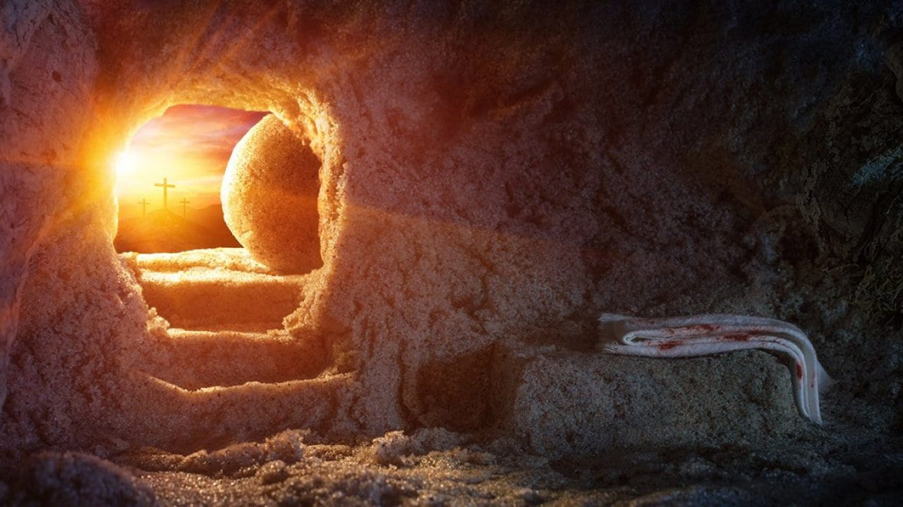
‘Resurrection’
Mary Ann Bernard

Slide 33
Chorus:
“Goodness is stronger than evil
Love is stronger than hate
Light is stronger than darkness
Life is stronger than death.
Victory is ours! Victory is ours!
Through Him who loved us.
Victory is ours! Victory is ours!
Through Him who loved us.”

Slide 34
A time of prayer:
Resurrection God I bring before you now my hopes, desires, needs and concerns and I trust that you hear me and help me.
For your church, a people of resurrection; frightened, weary, hopeful – may we all know your love empowering us to live the life we are gifted.

Slide 35
For your world, a people and creation; frightened, weary, determined – may we all know your love empowering us to live the life we are gifted.
For your vulnerable ones, the sick, the grieving, the isolated; frightened, weary, loved – may we all know your love empowering us to live the life we are gifted.

Slide 36
I especially want to pray for …..
Resurrection God,
These are my prayers, our hopes, concerns, desires and needs and I trust that you hear me and will help me, help me to be your hands, your feet, your voice in all those situations and with all those people who need to know your gift of life. Amen.
Our Father ……

Slide 37
1 Thine be the glory,
Risen, conquering Son;
Endless is the victory
Thou o’er death hast won.
Angels in bright raiment
Rolled the stone away,
Kept the folded grave-clothes
Where Thy body lay.
StF 313

Slide 38
Thine be the glory,
Risen, conquering Son;
Endless is the victory
Thou o’er death hast won!

Slide 39
2 Lo, Jesus meets us,
Risen from the tomb!
Lovingly He greets us,
Scatters fear and gloom.
Let the church with gladness
Hymns of triumph sing,
For her Lord now liveth,
Death hath lost its sting.

Slide 40
Thine be the glory,
Risen, conquering Son;
Endless is the victory
Thou o’er death hast won!

Slide 41
3/3 No more we doubt Thee,
Glorious Prince of life;
Life is naught without Thee:
Aid us in our strife;
Make us more than conquerors,
Through Thy deathless love;
Bring us safe through Jordan
To Thy home above.

Slide 42
Thine be the glory,
Risen, conquering Son;
Endless is the victory
Thou o’er death hast won!

Slide 43
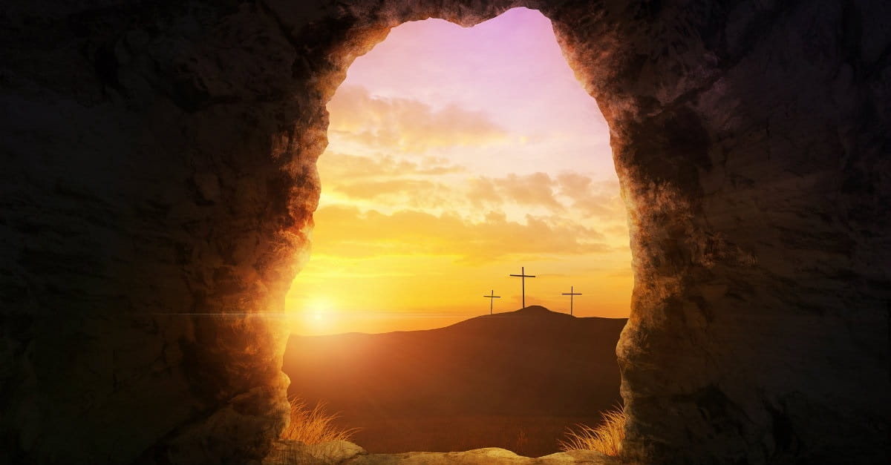

Slide 44
May you know life rising from the death,
May you know hope rising from the pain,
May you know light rising from the darkness,
May you know and live love,
May you know and live the life you are gifted.
Amen

